Slide 1
Design of Mixed-Criticality Applications on Distributed Real-Time Systems
Domițian Tămaș-Selicean

Slide 2
Outline
Introduction
Design optimizations at the processor-level
System and application models
Motivational examples
Optimization strategy
Experimental results
Realistic case study
Design optimizations at the communication network-level
ARINC 664p7 “Aircraft Data Network” and TTEthernet
Motivational examples
Optimization strategy
Experimental results
Realistic case study
Summary

Slide 3







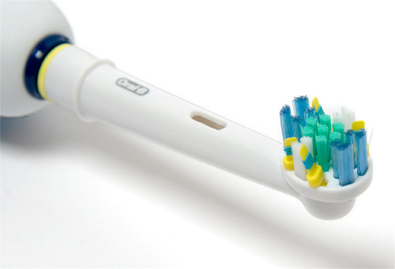


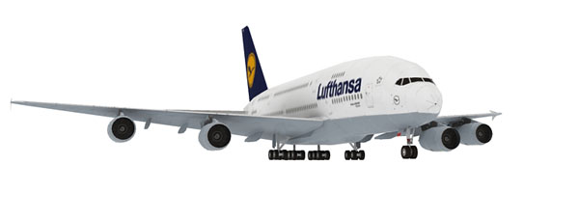
Introduction: embedded systems
embedded / real-time
embedded
Notes:
Most people, when they think of computing devices, they think only of desktop and portable computer. But only 2% of the manufactured microprocessors are used in such general purpose computers. The rest of 98% are used in embedded systems.
An embedded system is a computer-based system embedded in a larger system that it controls, repeatedly carrying out a particular function and not designed to be programmed by the end user in the same way that a personal computer (PC) is.
Many embedded systems are real-time systems, in which “the correctness of the system behavior depends not only on the logical results of the computations, but also on the physical time when these results are produced”
One key characteristic of any real-time system is its deadline, which is the latest time instant when the system must complete its execution, or a result must be produced. Depending on the consequences of missing the deadline, real-time systems can be soft or hard. Soft real-time systems can miss the deadlines once in a while, as the system will still function, but with degraded service. Example of such systems are home entertainment systems and mobile phones. In hard real-time systems, missing a deadline will lead to the failure of the system.
<number>

Slide 4
Introduction: mixed-criticality systems
embedded / real-time / safety-critical / mixed-critical
embedded / real-time / safety-critical
embedded / real-time
Notes:
This thesis is focused on safety- and mixed-criticality real-time systems
A safety-critical system is a system whose failure might endanger human life or the environment. Safety-critical systems have to be certified. There are several criticality levels, called SILs, which dictate the development processes and certification procedures that have to be followed.
A mixed-criticality system is “an integrated suite of hardware, operating system and middleware services and application software that supports the execution of safety-critical, mission-critical, and non-critical software within a single, secure computing platform”. The em- bedded systems in a vehicle form a mixed-criticality system, as they implement safety- critical applications (e.g., ABS) and non-critical applications (e.g., diagnostics soft- ware).
<number>

Slide 5
Introduction: evolution of architectures
Federated Architecture
Integrated Architecture
Partitioned Architecture
SIL4
SIL1
SIL4
SIL4
SIL4
SIL4
SIL3
SIL3
SIL4
SIL1
SIL3
SIL3
SIL2
SIL4
SIL4
SIL4
SIL3
SIL4
SIL4
SIL4
SIL4
SIL1
PE
Application A ₁
Application A ₂
SIL4
SIL1
Application A ₃
SIL: Safety Integrity Level
dictates certification costs
No separation:
certification is expensive
Separation through partitioning
Notes:
<number>

Slide 6
Introduction
Notes:
The methods presented in this thesis focus on the early life cycle phases, where the impact of design decisions is greatest. This impact is shown by comparing, for each life cycle stage, the actual expenditures (cost incurred) with the planned costs based on design and engineering decisions (cost committed), see Fig. 1.5 (adapted from [54]). Although at the end of the engineering development stage, when the final system design is produced, only about 20% of the cost is incurred, but 80% of the cost is already committed [54].
Thus, more design effort is needed in the early life cycle phases, since the decisions taken during these phases have a high impact and commit a lot of costs. In this thesis, we provide methods and tools to be used during the early design stages, to help the system engineers take better decisions, and thus reduce the costs.
<number>

Slide 7
Introduction: design space exploration
Application model
Platform model
CPU-level design tasks:
Mapping of tasks to processors
Partitioning
Task schedules
Design tasks
Network-level design tasks:
Packing of messages into frames
Routing of frames
Frame schedules
System implementation model
Evaluation
Evaluation: worst-case schedulability analysis
Operational architecture
Notes:
During the concept development stage the engineers examine potential system concepts and design alternatives, and select the preferred. Engineers select the preferred alternative after performing a trade-off analysis, which evaluates several design alternatives in terms of design metrics. The creation and evaluation of alternatives is called “design space exploration” (DSE).
DSE starts from models of the application functionality and system platform. There are many ways to model an application functionality
For the platform, we consider heterogeneous distributed platforms, consisting of processing elements interconnected using the TTEthernet [28] communication protocol. We as- sume the platform implements partitioning mechanisms similar to Integrated Modular Avionics (IMA), so that each application can execute only in its own partition. More- over, partitions can implement different scheduling policies. In this thesis we con- sidered several scheduling policies such as non-preemptive static cyclic scheduling or preemptive fixed-priority scheduling.
DSE is performed in the “Design Tasks” box. These tasks are done during the early lifecycle phases. DSE could be done manually for small designs, but in practice it is typically supported by tools, which perform an automatic DSE. These tools use op- timization techniques to search for solutions which optimize a set of design criteria called objectives.
The solutions are evaluated using objectives. There are multi-objective optimizations such as Evolutionary Algorithms [60], but we have used Tabu Search, where the mul- tiple objectives have been collapsed into a single objective using the weighted sum method [66]. The evaluation of each implementation alternative can be done either analytically or via simulation.
<number>

Slide 8
Outline
Introduction
Design optimizations at the processor-level
System and application models
Motivational examples
Optimization strategy
Experimental results
Realistic case study
Design optimizations at the communication network-level
ARINC 664p7 “Aircraft Data Network” and TTEthernet
Motivational examples
Optimization strategy
Experimental results
Realistic case study
Summary

Slide 9
System Model
SIL3
SIL3
SIL4
SIL1
Partition = virtual dedicated machine
Partitioned architecture
Spatial partitioning
protects one application’s memory and access to resources from another application
Temporal partitioning
partitions the CPU time among applications
SIL4
SIL3
SIL4
SIL1

Slide 10
System Model
SIL3
SIL3
SIL4
SIL1
PE 1
PE 2
PE 3
SIL4
SIL3
Partition
Partition
slice
SIL4
Major Frame
Temporal partitioning
Static partition table
Repeated with a period MF
Partition switch overhead
Each partition can have its own scheduling policy
A partition has a certain SIL
Problem: optimize task mapping
and allocation of partitions
SIL1

Slide 11
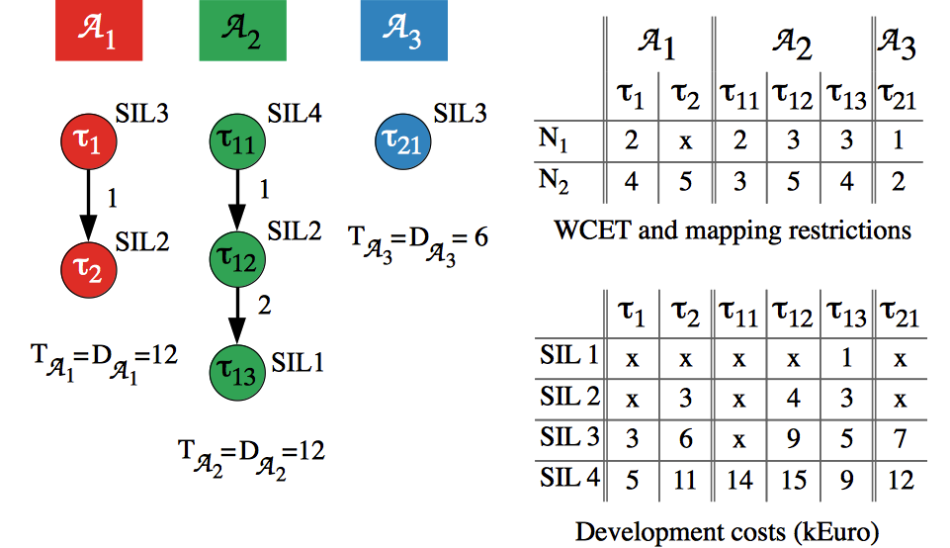
Application Model
Static Cyclic Scheduling
Problem: reduce development costs
Elevation: develop a task to a higher SIL
Notes:
Partition sharing
Tasks from different apps can share a partition if they have the same SIL
Elevation: increase the SIL of a task to allow partition sharing
Constraints
No sharing allowed: captured by a “separation requirements” graph
A task can receive input only from another task with the same or higher SIL
No communication between applications of different SILs
<number>

Slide 12
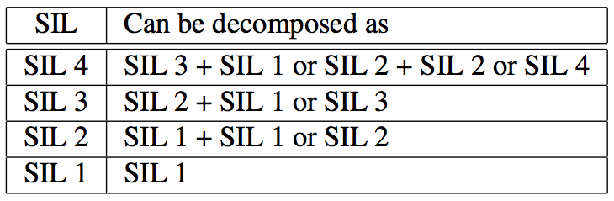
Application model
Task decomposition
Implementing a function of a higher SIL as several redundant tasks of a lower SIL.
Problem: optimize task decomposition
According to ISO 26262 “Road Vehicles – Functional Safety”
Notes:
<number>

Slide 13
Design tasks at the processor level
Given
A set of applications
The criticality level (or SIL) for each task
The separation requirements between tasks
A set of N processing elements (PEs)
The size of the Major Frame and of the Application Cycle
The decomposition library
Determine
The mapping of tasks to PEs
The sequence and length of partition slices on each processor
The assignment of tasks to partitions
The schedule for all the tasks in the system
The partition sharing
The task decomposition
Such that
All applications meet their deadline
The development costs are minimized

Slide 14
Design optimization problems: overview
Mapping
Deciding in which PE to place a task
Scheduling
Deciding the start times of static tasks
Partitioning
Deciding the sequence and sizes of partition slices
Task decomposition
Deciding how to implement a task to meet the SIL requirements
Elevation
Implementing a lower SIL task at a higher SIL
Notes:
<number>

Slide 15
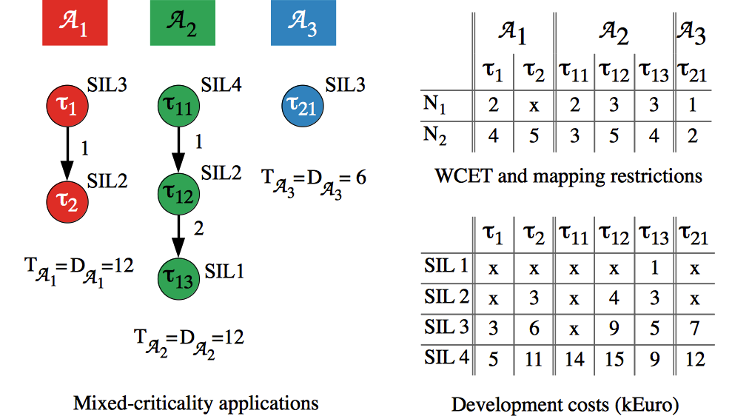
Motivational Example
Partition sharing optimization
Notes:
<number>

Slide 16
Motivational Example
No partition sharing allowed
τ₁₃ does not fit in the schedule
Partition sharing is allowed
Reassigning τ₂, τ₁₃ and τ₂₁ results in a successful schedule with DC = 44

Slide 17
Motivational Example
Partition sharing is allowed
Reassigning τ₂, τ₁₃ and τ₂₁ results in a successful schedule with DC = 44
Optimized partitioned sharing
Optimizing the mapping, partitioning and partition sharing results in schedulable implementation with DC = 37 and one extra time unit on N₂

Slide 18
Optimization Strategy
Mixed-Criticality Design Optimization (MCDO) strategy:
Tabu Search meta-heuristic
The mapping of tasks to processors
The sequence and length of partition slices on each PE
The assignment of tasks to partitions
The task decomposition
List scheduling
The schedule for the applications
Tabu Search
Explores the solution space using design transformations
Minimizes the cost function
Development cost
Constraint: schedulability
Notes:
<number>

Slide 19
Experimental Results
Benchmarks
7 synthetic
2 real life test cases from E3S
MCDO compared to:
MO+PO
Strategy where first we do a mapping optimization, without considering partitioning (MO), and then we perform a partitioning optimization, considering the mapping obtained previously as fixed (PO)
MPO
Mapping and partitioning optimization is done at the same time, but without considering partition sharing.
MP+PO and MPO use “degree of schedulability” as the cost function
Notes:
<number>

Slide 20
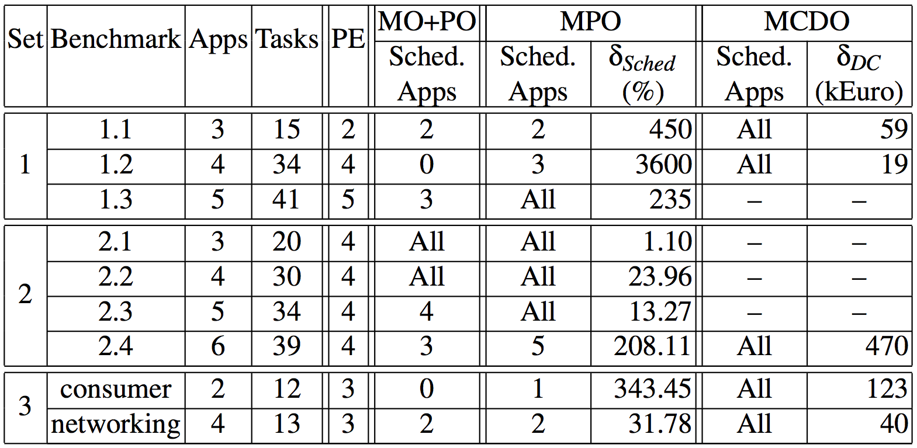
Experimental Results
It is important to simultaneously optimize the mapping and partitioning
Only by using partition sharing and SIL decomposition we can reduce costs
The optimization is important especially for large or loaded systems

Slide 21
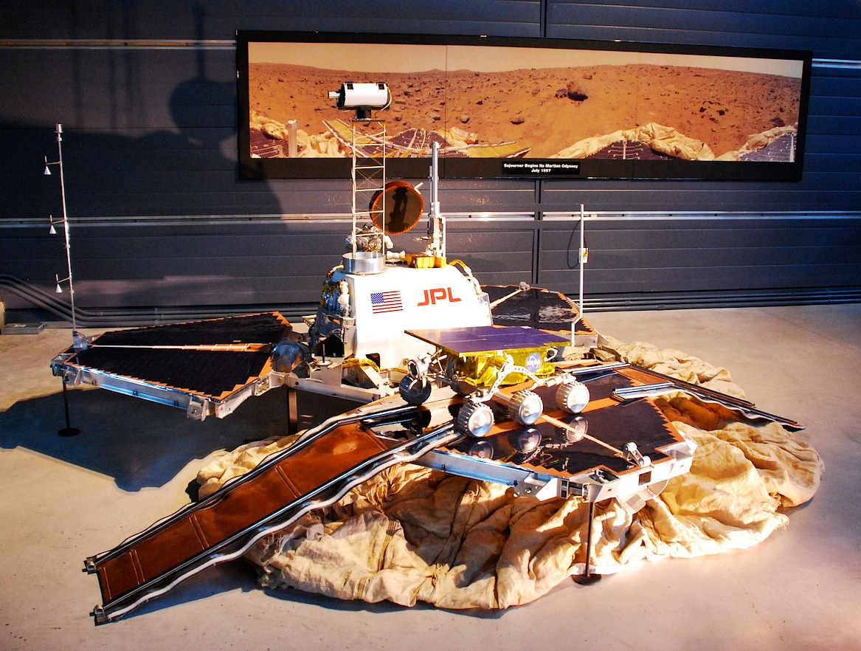
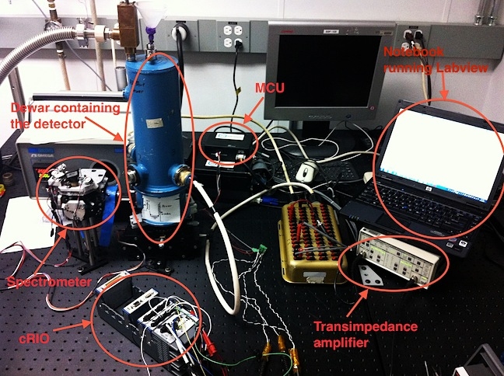
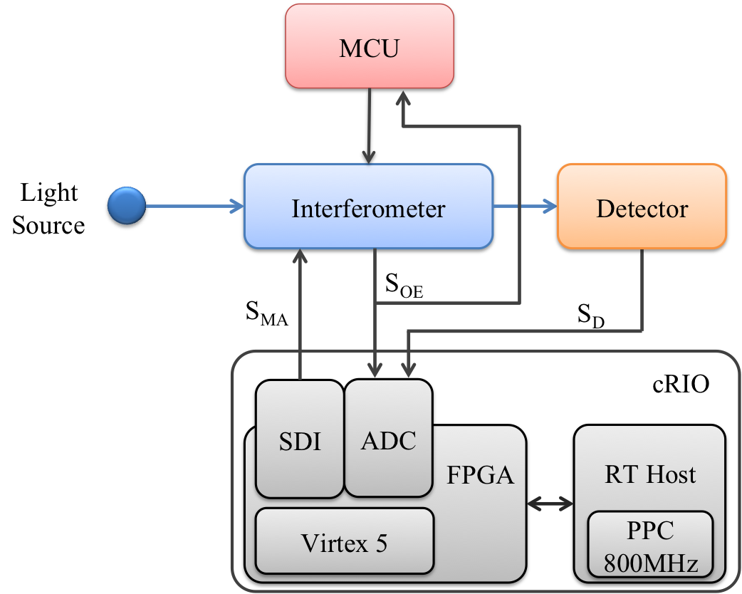
Realistic Case Study
(5 month JPL stay)
Easily extendable framework, to different design problems
Notes:
For the processor-level evaluation of partitioning, we chose two applications of different criticality levels. The proposed scenario is two have two applications of dif- ferent safety and time criticality integrated onto the same processor. One application is the Mars Pathfinder Mission, mixed-criticality application with hard real-time tasks.
The other application is non-critical; the controller for the Compositional Infrared Imaging Spectrometer (CIRIS), which is a Fourier Transform. The controller for CIRIS was developed during a research visit at JPL, NASA. The CIRIS tasks are soft real-time
We proposed an extension to our processor level optimization, that takes into account soft real-time tasks, and we modified the cost function, to incorporate the qulity of service for these tasks.
<number>

Slide 22
Outline
Introduction
Design optimizations at the processor-level
System and application models
Motivational examples
Optimization strategy
Experimental results
Realistic case study
Design optimizations at the communication network-level
ARINC 664p7 “Aircraft Data Network” and TTEthernet
Motivational examples
Optimization strategy
Experimental results
Realistic case study
Summary

Slide 23
ARINC 664 p7 “Aircraft Data Network”
ES₁
Network Switch
ES₃
NS₁
NS₂
ES₂
ES₄
NS₃
End System
Full-Duplex Ethernet-based data network for safety-critical applications
Notes:
ARINC 664 p7 specifies a full-duplex Ethernet network for aircraft data networks.
It is composed of End – Systems connected by Network Switches and physical connections.
<number>

Slide 24
ARINC 664 p7 “Aircraft Data Network”
ES₁
ES₃
NS₁
NS₂
ES₂
ES₄
NS₃
RAM
CPU
NIC
ROM
Notes:
Each End Systems consists of a Processing Element PE, containing a CPU, a a RAM and non-volatile memory, and a Network Interface Card
<number>

Slide 25
ARINC 664 p7 “Aircraft Data Network”
ES₁
NS₁ to ES₁
ES₃
NS₁
NS₂
ES₁ to NS₁
ES₂
ES₄
NS₃
dataflow link
Notes:
In half-duplex implementations, frame collision is unavoidable, leading to unbounded transmission times.
ARIC 664p7 is a full-duplex network, thus allows simultaneous communication in both directions, collisions-free.
<number>

Slide 26
ARINC 664 p7 “Aircraft Data Network”
ES₁
virtual link
ES₃
τ₁
vl₂
τ₂
τ₅
NS₁
NS₂
ES₂
ES₄
vl₁
τ₄
τ₃
NS₃
Highly critical application A ₁: τ₁, τ₂ and τ₃
τ₁ sends message m₁ to τ₂ and τ₃
Non-critical application A ₂: τ₄ and τ₅
τ₄ sends message m₂ to τ₅
Notes:
The Ethernet protocol does not offer separation between messages of different criticalities. ARINC 664p7 manages this through the concept of Virtual Links, by emulating point-to-point connectivity over the network. The virtual link is defined as the “logical unidirectional connection from one source system to one or more destination end systems”. Thus the virtual link is a directed tree, with the sender as a root, and the receivers as leaf. Each virtual link is composed of a set of dataflow paths, one such dataflow path for each root-leaf connection.
One virtual link is assigned to one message only.
By using virtual links, the highly critical message m1 is separated from the non-critical message m2.
Let’s assume we have 2 applications, A1 and A2.
<number>

Slide 27
ARINC 664 p7 “Aircraft Data Network”
dataflow path
ES₁
ES₃
τ₁
dp₁
τ₂
τ₅
l₁
l₃
NS₁
l₂
NS₂
Problem: optimize virtual link routing
l₄
ES₂
dp₂
ES₄
vl₁
τ₄
τ₃
NS₃
Highly critical application A ₁: τ₁, τ₂ and τ₃
τ₁ sends message m₁ to τ₂ and τ₃
Non-critical application A ₂: τ₄ and τ₅
τ₄ sends message m₂ to τ₅
Notes:
T1 of A1 sends m1 to T2 and T3 on vl1.
vl1 is composed of dataflow paths dp1 and dp2, where dp1 is connecting ES1 to ES3 and dp2 is connecting ES1 to ES4.
<number>

Slide 28
TTEthernet
ARINC 664p7 compliant
Traffic classes:
synchronized communication
Time Triggered (TT)
unsynchronized communication
Rate Constrained (RC) – ARINC 664p7 traffic class
Best Effort (BE) – no timing guarantees
Standardized as SAE AS 6802
Marketed by TTTech Computertechnik AG
Implemented by Honeywell on the NASA Orion Constellation
Notes:
<number>

Slide 29
TT Transmission
ES₁
NS₁
ES₂
CPU
CPU
P_{1,1}
FU
FU
B_{2,Rx}
P_{2,1}
τ₁
TT
τ₄
P_{1,2}
b
TT_{R}
B_{1,Tx}
TT_{S}
B_{1,Rx}
P_{2,2}
τ₂
B_{1,Tx}
TT_{S}
τ₃
b
B_{2,Tx}
f₂
B_{2,Tx}
b
P_{1,3}
a
P_{2,3}
S_{S}
a
S_{R}
S_{S}
a
a
f₃
NS₂
f₄
A₁: τ₁ à m₁ à τ₃, RC
NS₃
A₂: τ₂ à m₂ à τ₄, TT
TT frames send according to sending schedules
a
a
Window of acceptance based on receive schedules
b
b

Slide 30
RC Transmission
ES₁
f₁
1
NS₁
ES₂
1
2
CPU
2
3
RC
TP
Q_{Tx}
CPU
Q_{1,Tx}
TR₁
3
P_{1,1}
TR₂
RC_{S}
FU
FU
B_{2,Rx}
P_{2,1}
τ₁
Q_{2,Tx}
TT
τ₄
P_{1,2}
TT_{R}
B_{1,Tx}
TT_{S}
B_{1,Rx}
P_{2,2}
τ₂
B_{1,Tx}
TT_{S}
Q_{2,Rx}
τ₃
f₂
B_{2,Tx}
b
B_{2,Tx}
P_{1,3}
S_{S}
a
S_{R}
S_{S}
Q_{1,Rx}
P_{2,3}
a
f₃
NS₂
f₄
A₁: τ₁ à m₁ à τ₃, RC
NS₃
A₂: τ₂ à m₂ à τ₄, TT
TT frames send according to sending schedules
a
a
Window of acceptance based on receive schedules
b
RC frames characteristic: Bandwidth Allocation Gap (BAG)
1
1
Traffic regulator enforces the BAG for each VL
2
2
Traffic integration policies: timely block, preemption, shuffling
3
3
Notes:
<number>

Slide 31
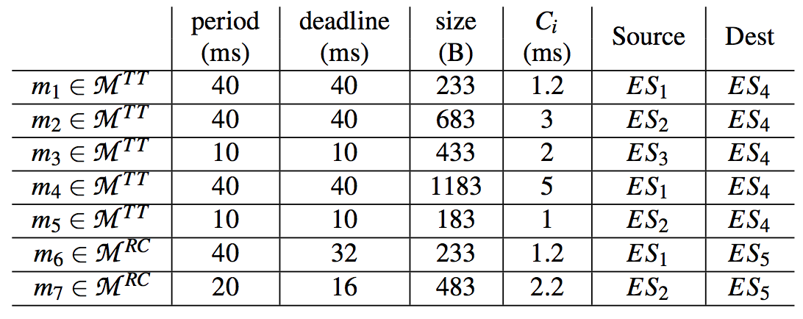
Application Model
Notes:
<number>

Slide 32
Worst-Case End-to-End Delay
Problem: optimize the schedules
for the TT frames
Notes:
<number>

Slide 33
Design tasks at the communication network-level
Given
The topology of the network
The set of TT and RC frames
For each frame the size, the deadline and the period
Determine
The fragmenting of messages and packing into frames
The assignment of frames to virtual links
The routing of virtual links
The bandwidth for each RC virtual link
The set of TT schedules
Such that
The deadlines for the TT and RC frames are satisfied

Slide 34
Design optimization problems: overview
Scheduling TT frames
Deciding the schedules of TT frames in ES and NS devices
Routing
Deciding the routing of virtual links
Bandwidth for RC VLs
Deciding the Bandwidth Allocation Gap for RC VLs
Fragmenting
Deciding if and how to split messages before transmission
Packing
Deciding which messages to pack into a frame
Notes:
<number>

Slide 35
Motivational Example
Notes:
<number>

Slide 36
Motivational Example
Baseline solution – no optimization
Routing optimization
Notes:
Rerouting the RC frame f7 is an alternative to obtain a schedulable solution
<number>

Slide 37
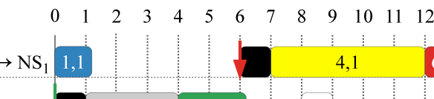
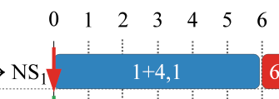
Motivational Example
Baseline solution – no optimization
Packing optimization
Notes:
<number>

Slide 38
Motivational Example
Baseline solution – no optimization
Schedule optimization
Reschedule frame f₅ on [ES₂, NS₁] and [NS₁, NS₃]
Notes:
<number>

Slide 39
Optimization Strategy
Design Optimization of TTEthernet-based Systems (DOTTS) :
Tabu Search meta-heuristic
The fragmenting of messages and packing in frames
The assignment of frames to virtual links
The routing of virtual links
The bandwidth for each RC virtual link
List scheduling
The schedules for the TT frames
Tabu Search
Explores the solution space using design transformations
Minimizes the cost function
Degree of schedulability for RC frames
Constraint: schedulability for all messages

Slide 40
Experimental Results
Benchmarks
8 synthetic
2 real life test cases
DOTTS compared to:
Routing Optimization (RO)
Optimizes the routing only.
Packing and Fragmenting Optimization (PFO)
Optimizes the fragmenting and packing.
Scheduling Optimization (SO)
Optimizes the scheduling of TT frames.
Notes:
<number>

Slide 41
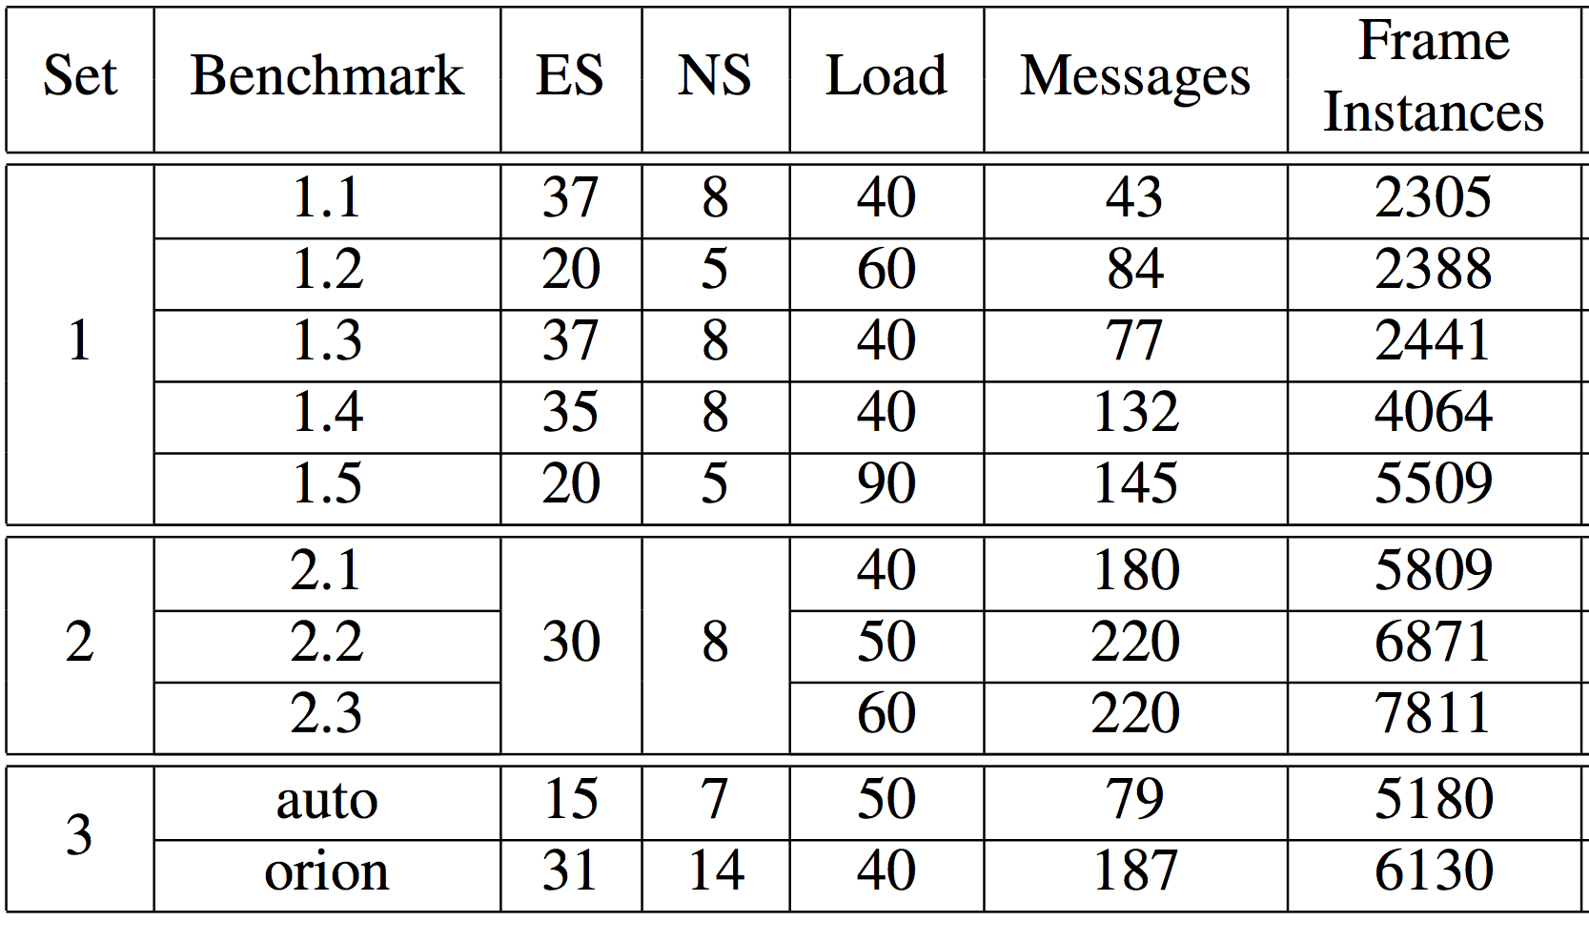
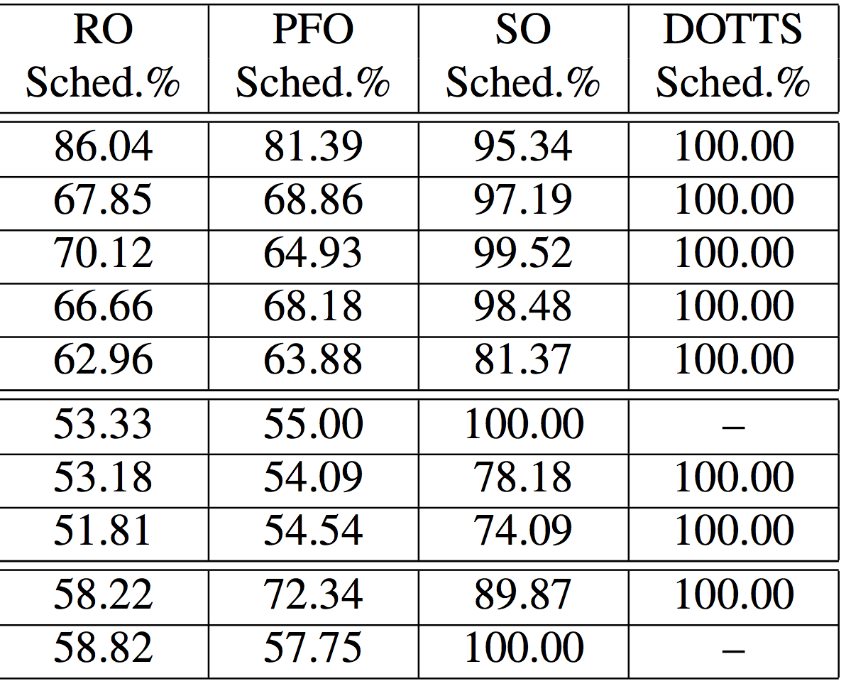
Experimental Results
SO yields the biggest improvement among RO, PFO and SO
It is necessary to simultaneously optimize the routing, packing and fragmenting, and scheduling, to obtain schedulable solutions.
Notes:
<number>

Slide 42
Realistic Case Study
Next generation space vehicle
Implements TTEthernet
The case study: network for CM and SM
Easily extendable framework, to different design problems
Extended DOTTS to:
perform architecture selection
capture QoS for BE traffic
Notes:
<number>

Slide 43
Outline
Introduction
Design optimizations at the processor-level
System and application models
Motivational examples
Optimization strategy
Experimental results
Realistic case study
Design optimizations at the communication network-level
ARINC 664p7 “Aircraft Data Network” and TTEthernet
Motivational examples
Optimization strategy
Experimental results
Realistic case study
Summary

Slide 44
Summary
Design problems at the processor-level:
Mapping of tasks to PEs
Deciding the sequence and length of partition slices on each PE
Assignment of tasks to partitions
Task decomposition
Schedule table generation
Response time analysis for tasks using FPS in partitioned architectures
Addressed also soft real-time applications
Design problems at the communication network-level:
Deciding the fragmenting and packing of messages into frames
Routing of virtual links
Generation of schedules for TT frames
Architecture selection to reduce the cost of the system
Addressed also BE traffic
It is important to provide design support tools to successfully implement mixed-criticality applications with competing constraints as safety, schedulability and costs

Slide 45
Design of Mixed-Criticality Applications on Distributed Real-Time Systems
Domițian Tămaș-Selicean

